Slide 1



Egocentric Action Recognition
Machine Learning and Deep Learning
Teaching Assistant: Simone Alberto Peirone (simone.peirone@polito.it)
Chiara Plizzari (chiara.plizzari@polito.it)

Slide 2
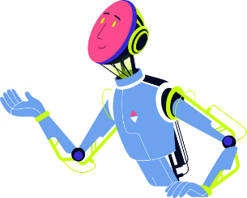




Why Egocentric Action Recognition?
Learn how humans interact with world and improve human-robot cooperation
Assistive robotics
Autonomous driving
Industrial applications
Augmented reality
[1] Núñez-Marcos et al,”Egocentric Vision-based Action Recognition: A survey”, Neurocomputing 2022
Notes:
With egocentric action recognition we can learn how humans interact with the world and how robots can effectively interact with humans. The number of downstream tasks that EAR enables is large, from assistive robotics, autonomous driving, industrial applications and augmented reality.

Slide 3

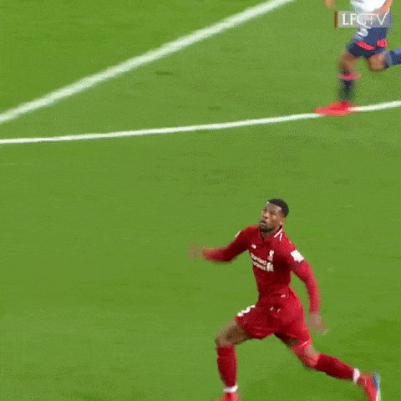
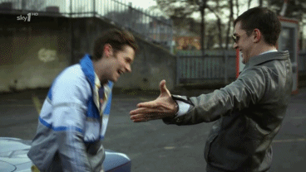
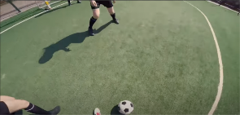
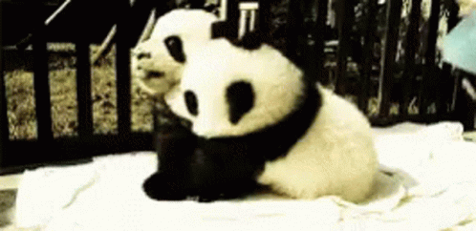
A) Domain Adaptation for Egocentric Action Recognition
View-point Shift
Actor Shift

Slide 4
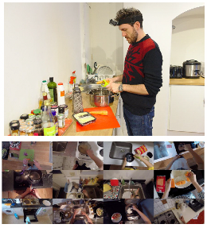
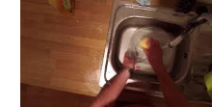
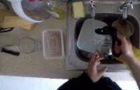
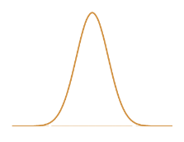
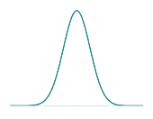


A) Domain Adaptation for Egocentric Action Recognition
Align the data distributions of the source and target domains
Domain shift
Source distribution
Target distribution

Slide 5
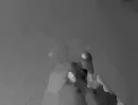
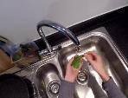
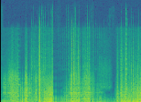


B) Multiple Modalities for Action Recognition
Videos provide multiple sources of information (a.k.a modalities) that
we can use for action recognition
RGB frames
Optical flow
Audio
Visual appearance
(objects and scenes)
Suffers from occlusions and blur
Focused on motion
Computationally expensive
Lightweight
Not all activities are recognizable from audio only
Each modality has its own strengths and weaknesses

Slide 6
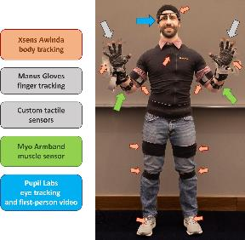
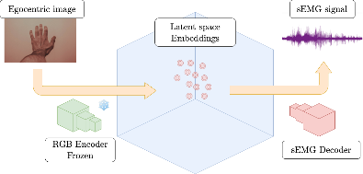
B) Multiple Modalities for Action Recognition
Combine egocentric vision with wearable sensors
Reconstruct the EMG signal from RGB frames

Slide 7
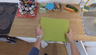
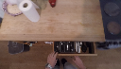
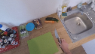
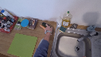
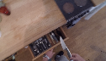
From the previous year...
A window of n actions
Source Dataset
Seen Action
P1
P1
P1
P1
p2
p2
p2
p2
Re-weight predictions
on target
Seen Action Probability Vector
….
….
….
….
pn
pn
pn
pn

Slide 8

Domain Adaptation for Egocentric Action Recognition
Steps:
○ Study Related Works to get familiar with the tasks and dataset;
○ Implementation of the Egocentric Action Recognition models, on both RGB, Optical Flow and Audio modalities;
○ Implementation and testing a popular Domain Adaptation technique;
○ Definition, implementation and testing of an Improvement to the overall framework or
○ Make a participation in the EK-UDA challenge. Find out more @
https://github.com/epic-kitchens/C4-UDA-for-Action-Recognition

Slide 9
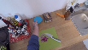
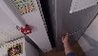
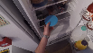
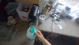

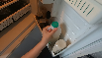
From the previous year...
Different domain with
the same sequence of actions

Slide 10

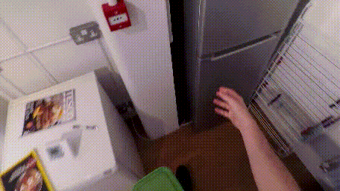
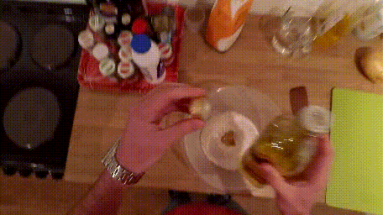
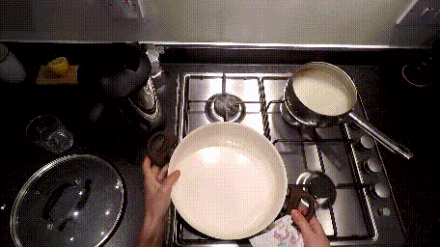
Egocentric Action Recognition (EAR)
A classification problem that aims to assign labels to videos
Action video
Label
Neural network
Examples
Open fridge
Close oil
Place pan on hob

Slide 11
Egocentric Vision
Videos provide multiple sources of information (a.k.a modalities) that
we can use for action recognition
RGB frames
Optical flow
Audio
Visual appearance
(objects and scenes)
Suffers from occlusions and blur
Focused on motion
Computationally expensive
Lightweight
Not all activities are recognizable from audio only
Each modality has its own strengths and weaknesses

Slide 12
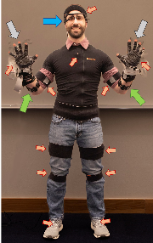
Egocentric vision + wearable sensors
Combine egocentric vision with wearable sensors
EMG sensors
measures the electrical activity of the muscles
Eye tracking
detects where the eyes are looking at
Tactile sensors
measure the force exerted on the fingers through touch
Body and finger tracking
senses the acceleration and velocity of your body
[3] DelPreto, Joseph, et al. "ActionNet: A Multimodal Dataset for Human Activities Using Wearable Sensors in a Kitchen Environment." NeurIPS22

Slide 13
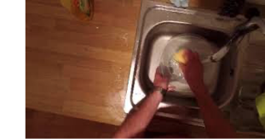
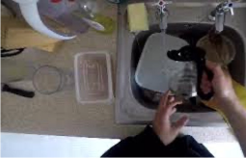
Domain Adaptation
target
Domain shift
source distribution
target distribution
Damen, Dima, Hazel Doughty, Giovanni Maria Farinella, Sanja Fidler, Antonino Furnari, Evangelos Kazakos, Davide Moltisanti et al. "Scaling egocentric vision: The epic-kitchens dataset." ECCV ‘2018.

Slide 14
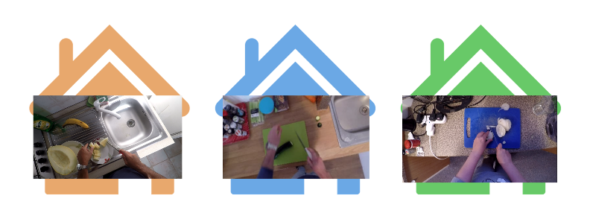
Domain Shift in Egocentric Vision
Environmental Shift
[1] Damen et al. "Scaling egocentric vision: The epic-kitchens dataset." ECCV ‘2018.

Slide 15
Domain Adaptation
target
Domain shift
source distribution
target distribution
Damen, Dima, Hazel Doughty, Giovanni Maria Farinella, Sanja Fidler, Antonino Furnari, Evangelos Kazakos, Davide Moltisanti et al. "Scaling egocentric vision: The epic-kitchens dataset." ECCV ‘2018.

Slide 16



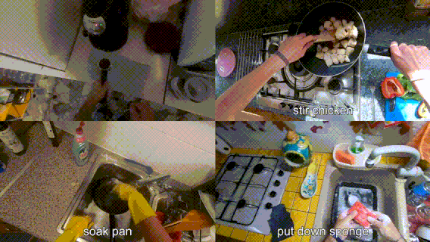
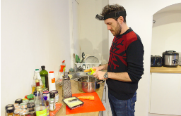
The EPIC-Kitchens dataset (2018)
https://epic-kitchens.github.io
32 participants
55+ recorded hours
39k action segments in a kitchen

Slide 17
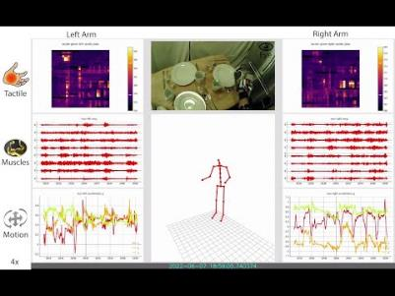
The Action-Net dataset (2022)
https://action-net.csail.mit.edu
10 subjects
12+ recorded hours
20 unique activities
Eye tracking
RGB/RGB-D cameras
Microphones
Tactile sensors
Body tracking
EMG sensors
A large number of cameras (head-mounted and external) and wearable sensors
[2] DelPreto, Joseph, et al. "ActionNet: A Multimodal Dataset for Human Activities Using Wearable Sensors in a Kitchen Environment." NeurIPS22
Notes:
We can go further extend the capability of egocentric vision with the use of sensors.
In particular in this

Slide 18

Project Details
Multiple modalities for Action Recognition
Domain Adaptation for Action Recognition

Slide 19
Project A:
Multiple Modalities
for Action Recognition

Slide 20

Project steps
Get familiar with egocentric vision and multimodal learning
Implement common baselines using RGB and optical flow on the EK-55 dataset.
Implement one of the following variations:
Multimodal training with RGB and EMG on Action-Net.
A variational autoencoder to translate from RGB to EMG and viceversa on Action-Net. Reconstruct the missing EMG signal in EK and use it to implement a classifier.

Slide 21
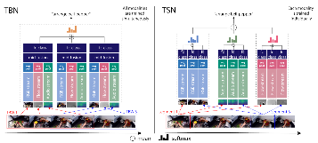
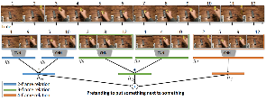
Project steps
Get familiar with egocentric vision and multimodal learning
Implement common baselines using RGB and optical flow on the EK dataset.
Implement one of the following variations:
Multimodal training with RGB and EMG on Action-Net.
A variational autoencoder to translate from RGB to EMG and viceversa on Action-Net. Reconstruct the missing EMG signal in EK and use it to implement a classifier.
Temporal Binding Network [3] and Temporal Segment Network [4]
Temporal Relational Reasoning in Videos [5]
[3] Kazakos et al. “Epic-fusion: Audio-visual temporal binding for egocentric action recognition”. ICCV 2019
[4] Wang et al. "Temporal segment networks for action recognition in videos." TPAMI 2018
[5] Zhou et al. "Temporal relational reasoning in videos." ECCV 2018

Slide 22
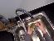
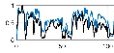
Project steps
Get familiar with egocentric vision and multimodal learning
Implement common baselines using RGB and optical flow on the EK dataset.
Implement one of the following variations:
Multimodal training with RGB and EMG on Action-Net.
A variational autoencoder to translate from RGB to EMG and viceversa on Action-Net. Reconstruct the missing EMG signal in EK and use it to implement a classifier.
Predictions
Neural network
Class labels

Slide 23
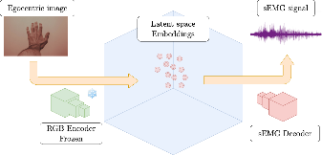
Project steps
Get familiar with egocentric vision and multimodal learning
Implement common baselines using RGB and optical flow on the EK dataset.
Implement one of the following variations:
Multimodal training with RGB and EMG on Action-Net.
A variational autoencoder to translate from RGB to EMG and viceversa. Reconstruct the missing EMG signal on EK-55 and use it to implement a classifier.

Slide 24
Project B:
Domain Adaptation
for Action Recognition

Slide 25
Bibliography
[1] Núñez-Marcos, Adrián, Gorka Azkune, and Ignacio Arganda-Carreras. "Egocentric vision-based action recognition: a survey." Neurocomputing 472 (2022): 175-197.
[2] Damen, D., Doughty, H., Farinella, G. M., Fidler, S., Furnari, A., Kazakos, E., ... & Wray, M. (2018). Scaling egocentric vision: The epic-kitchens dataset. In Proceedings of the European Conference on Computer Vision (ECCV) (pp. 720-736).
[3] DelPreto, Joseph, et al. "ActionNet: A Multimodal Dataset for Human Activities Using Wearable Sensors in a Kitchen Environment." Thirty-sixth Conference on Neural Information Processing Systems Datasets and Benchmarks Track.
[4] Kazakos, Evangelos, et al. "Epic-fusion: Audio-visual temporal binding for egocentric action recognition." Proceedings of the IEEE/CVF International Conference on Computer Vision. 2019.
[5] Wang, Limin, et al. "Temporal segment networks for action recognition in videos." IEEE transactions on pattern analysis and machine intelligence 41.11 (2018): 2740-2755.
[6] Zhou, Bolei, et al. "Temporal relational reasoning in videos." Proceedings of the European conference on computer vision (ECCV). 2018.

Slide 26

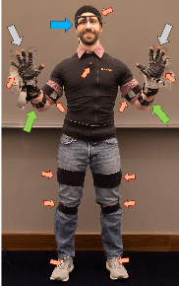
Multimodal Egocentric Action Recognition
Teaching Assistant: Simone Alberto Peirone (simone.peirone@polito.it)
The objective of this project is to explore multimodal Egocentric Action Recognition (EAR), starting from traditional approaches based on RGB, optical flow and audio and moving towards new modalities enabled by wearable sensors. The student should understand typical approaches used in egocentric vision and how multiple modalities can be combined together to perform action recognition or to compensate for the absence of other modalities.
The project is organized in the following steps:
Get familiar with egocentric vision and multimodal learning, the task of egocentric action recognition and the most common datasets in the field.
Implement EAR models using RGB and optical flow on the EPIC-KITCHENS dataset.
Implement one of the following variations:
Train a multimodal model on the Action-Net [1] dataset using RGB frames and EMG signals measuring the wearer's muscle activity.
Train a variational autoencoder on the Action-Net dataset to translate from RGB to EMG and viceversa. Reconstruct the missing EMG signal on EPIC-KITCHENS [2] and use it to implement a classifier.
Link to project details
[1] DelPreto, Joseph, et al. "ActionNet: A Multimodal Dataset for Human Activities Using Wearable Sensors in a Kitchen Environment." NeurIPS22
[2] Damen, Dima, et al. "Scaling egocentric vision: The epic-kitchens dataset." ECCV 2018.

